Slide 2
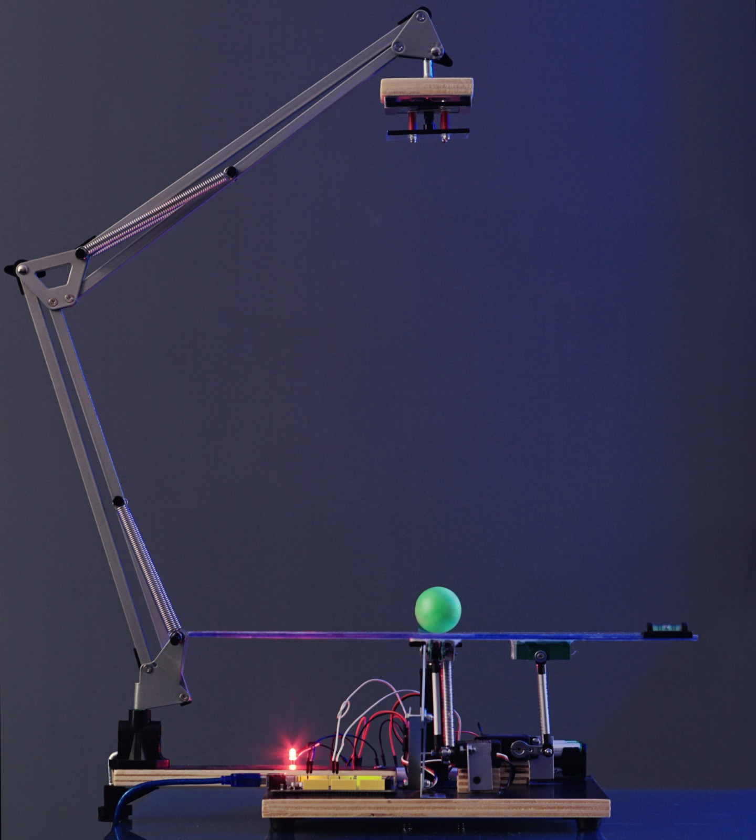
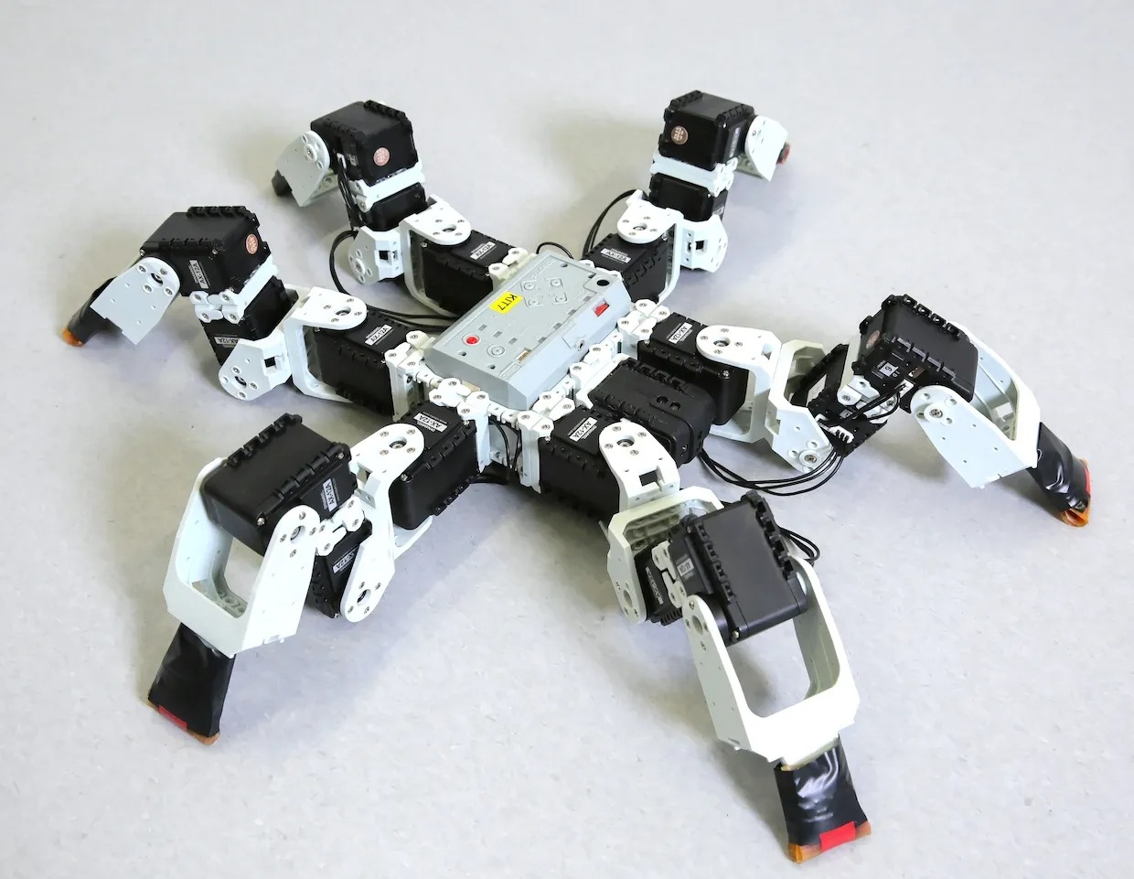
Introduction
This is a balance board that is equipped with legs

Slide 3
Objectives
Main function
The objective is to create a balancing plate using different mechanical, electrical and programming components. The goal is achieved when it can keep an object on a plate from falling.
Secondary function
Making the balancing plate mobile to increase the usability of the product. The movement will be created with two wheels attached to motors.

Slide 4

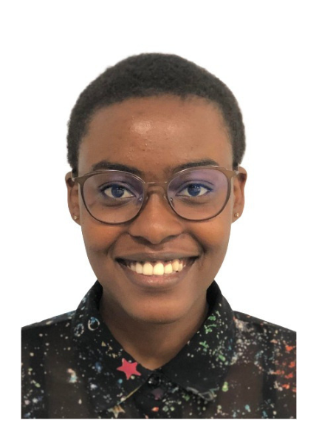


Team Organization
Isaac
Project Manager
Aïda
Electronics
David
Mechanics
Hortense
Programming

Slide 5
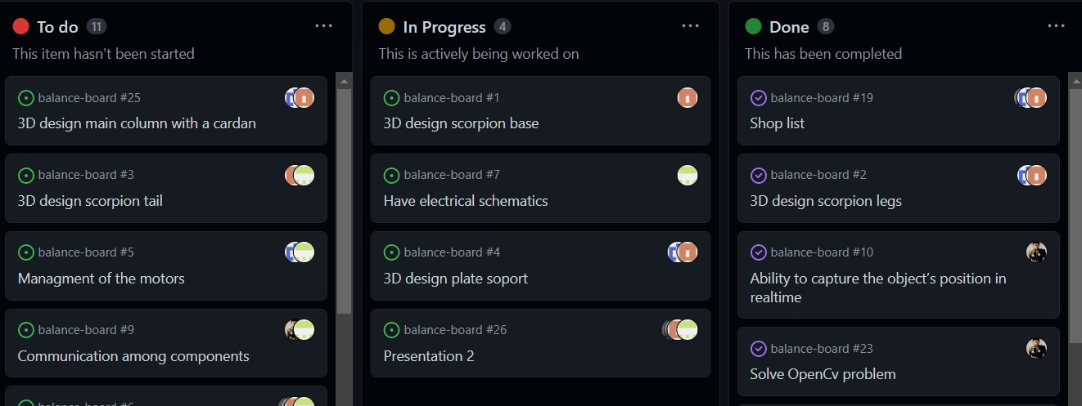
Team Organization & Management tool
https://github.com/Integrated-Project-2-2023-UVic-UCC/balance-board

Slide 6
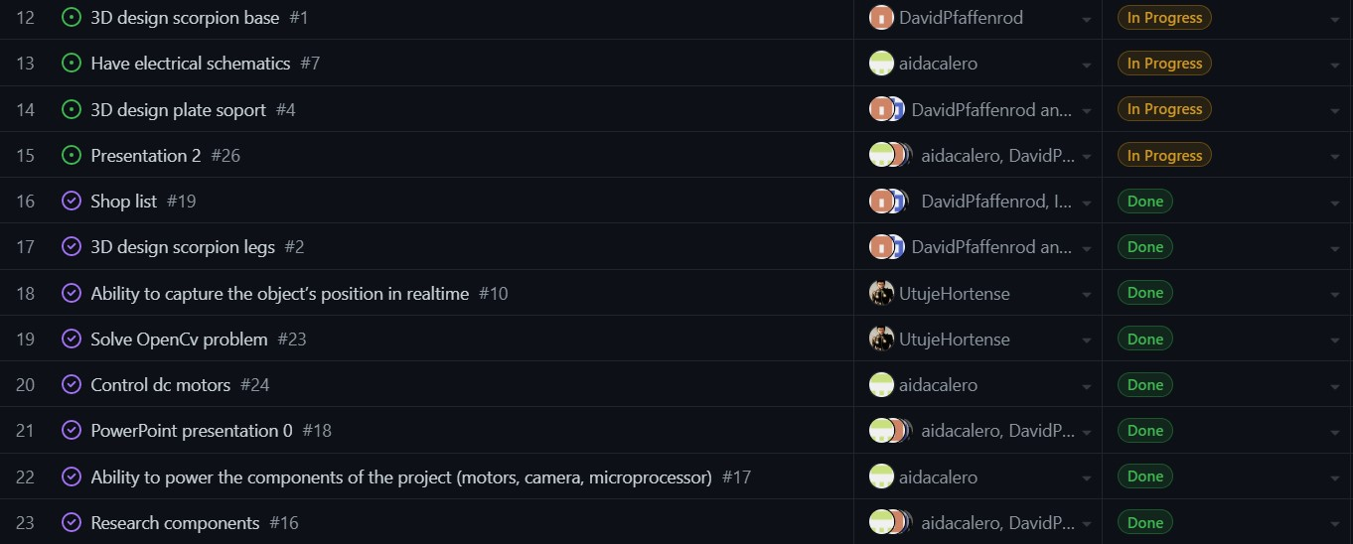
Team Organization & Management tool

Slide 7
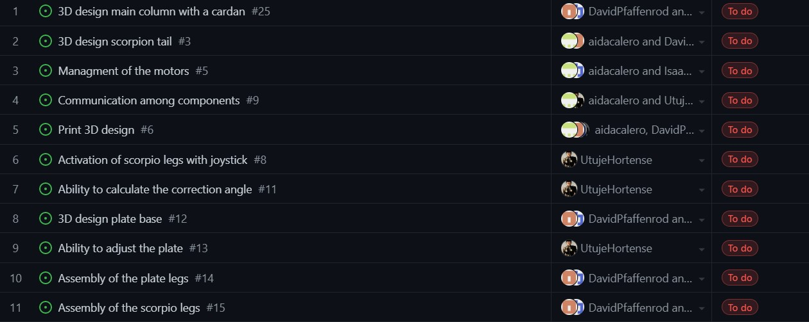
Team Organization & Management tool

Slide 8

Team Organization & Management tool
Evaluate your team:

Slide 9
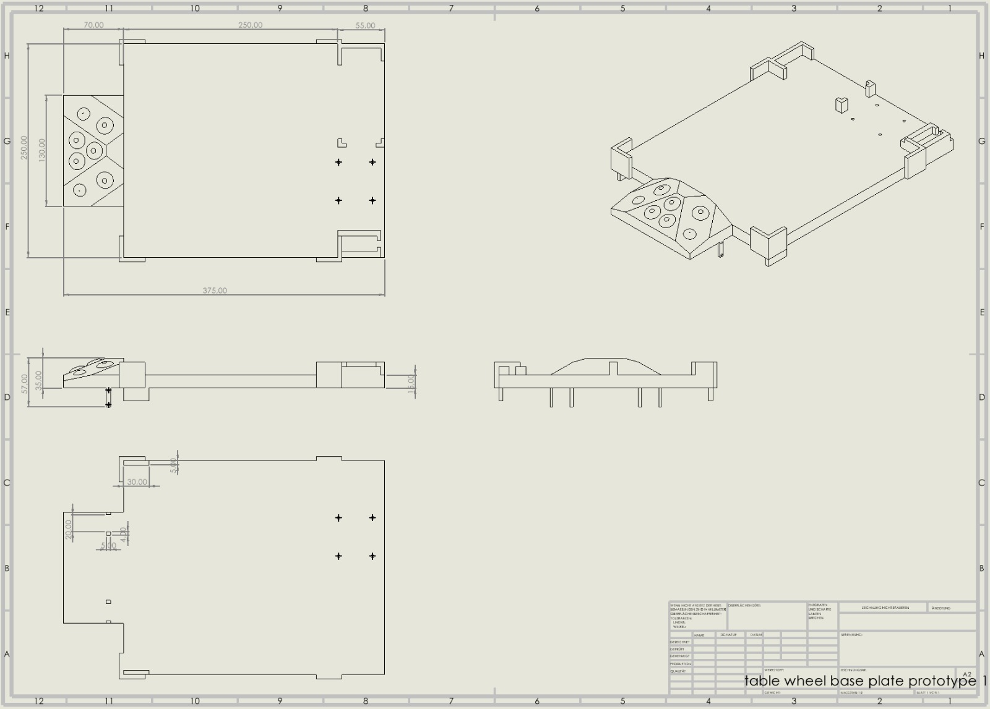
Prototype
In the Mechanical domain:

Slide 10
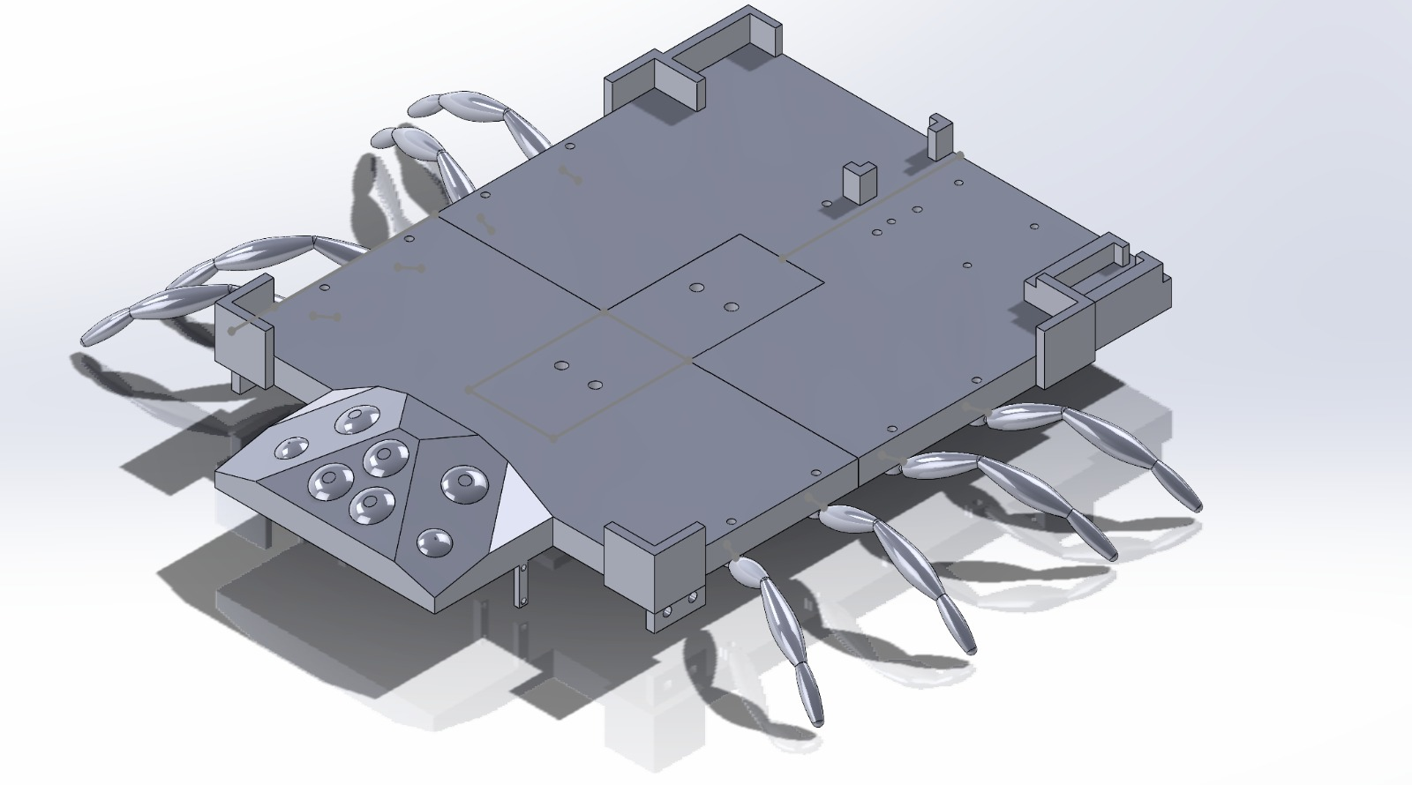
Prototype
In the Mechanical domain:
In the Mechanical domain:

Slide 11
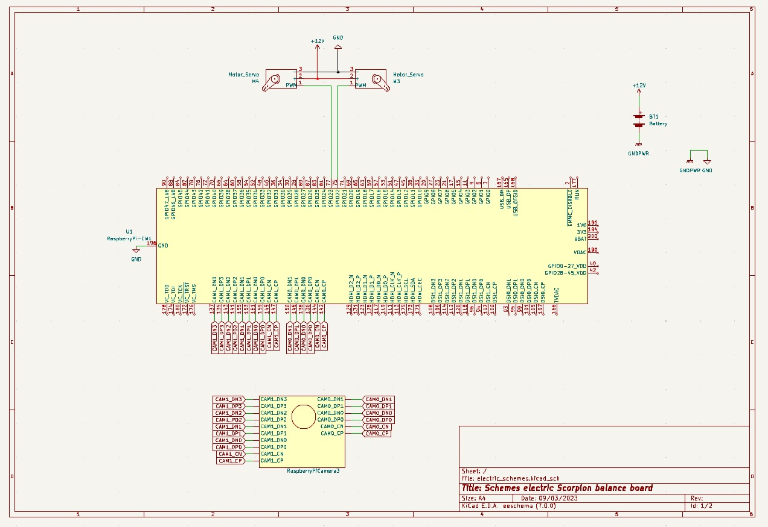
Prototype
In the Electrical/Electronics domain:

Slide 12
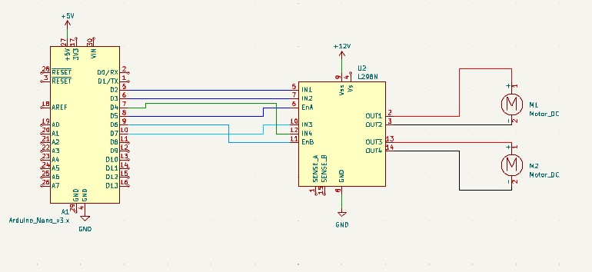
Prototype
In the Electrical/Electronics domain:

Slide 13
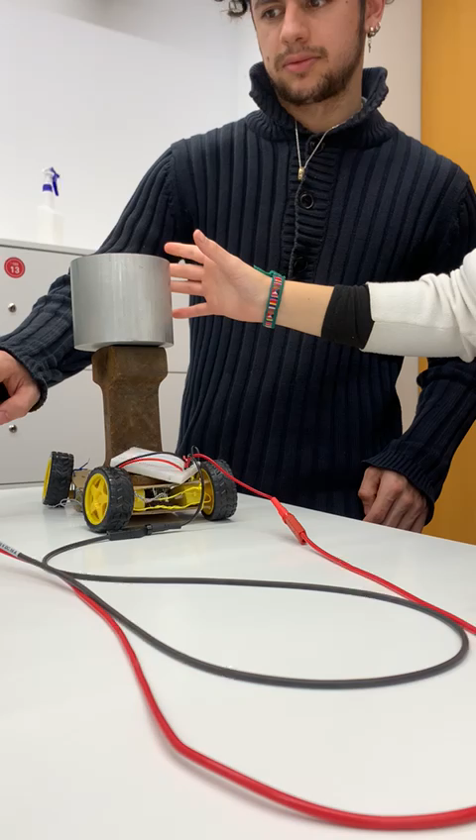
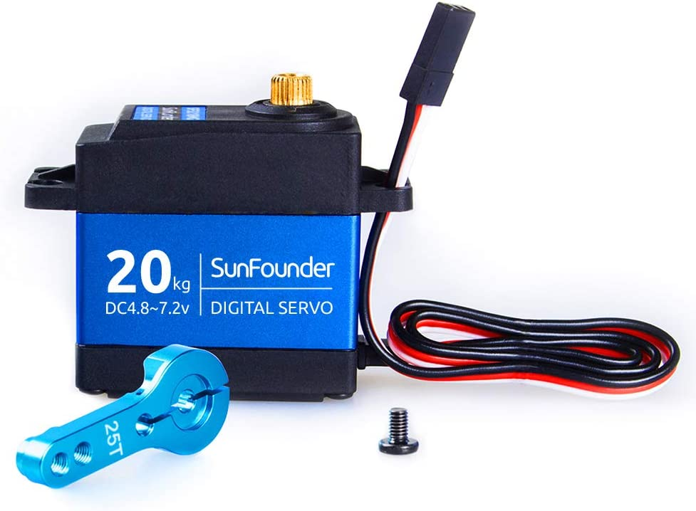
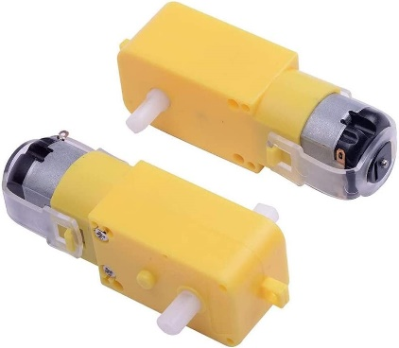
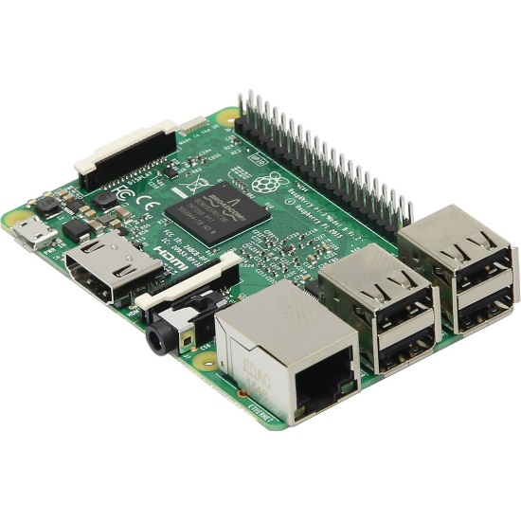
Prototype
In the Electrical/Electronics domain:
7.2V
12V
5V

Slide 14
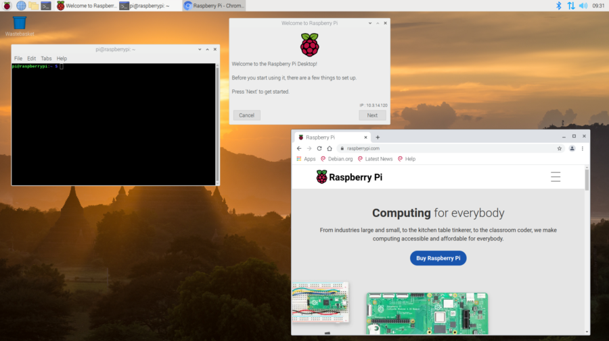
Prototype
Programming domain:
Raspberry config
Image processing
Servo motor connection
Bluetooth connection

Slide 15
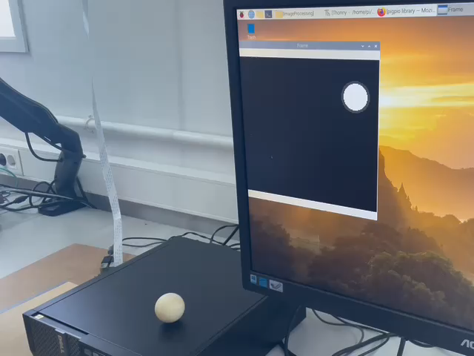
Prototype
Programming domain:

Slide 16
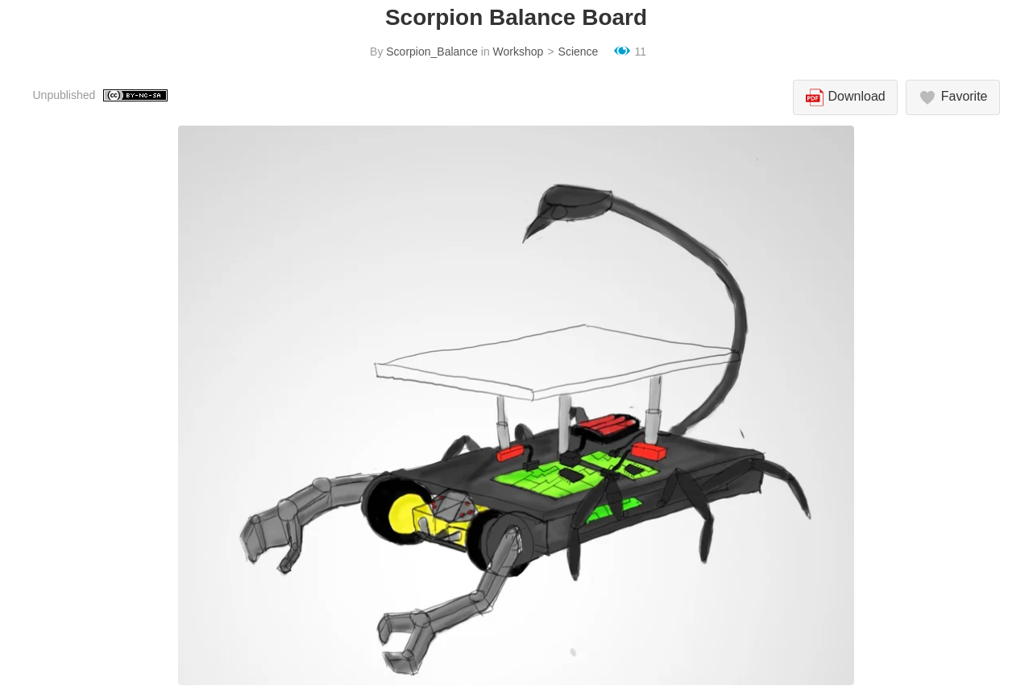
Website update

Slide 17
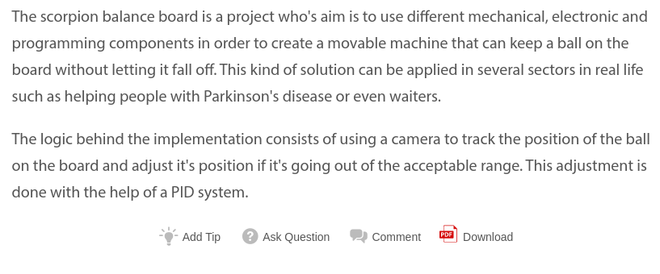
Website update

Slide 18
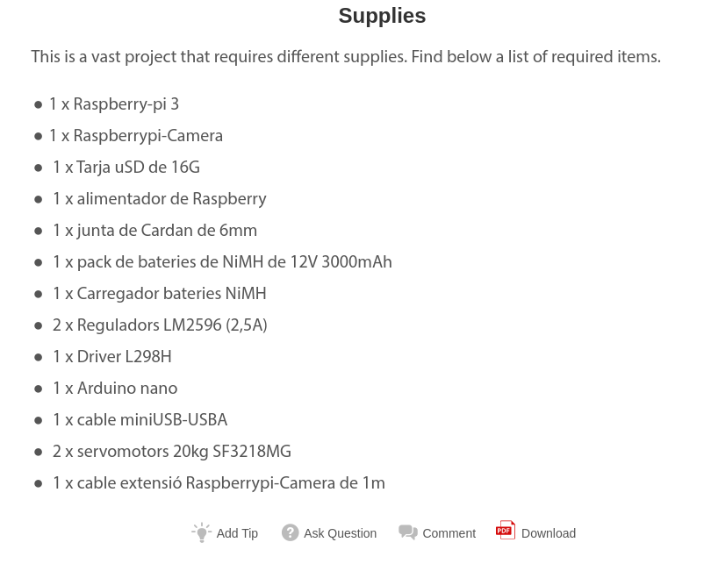
Website update

Slide 19
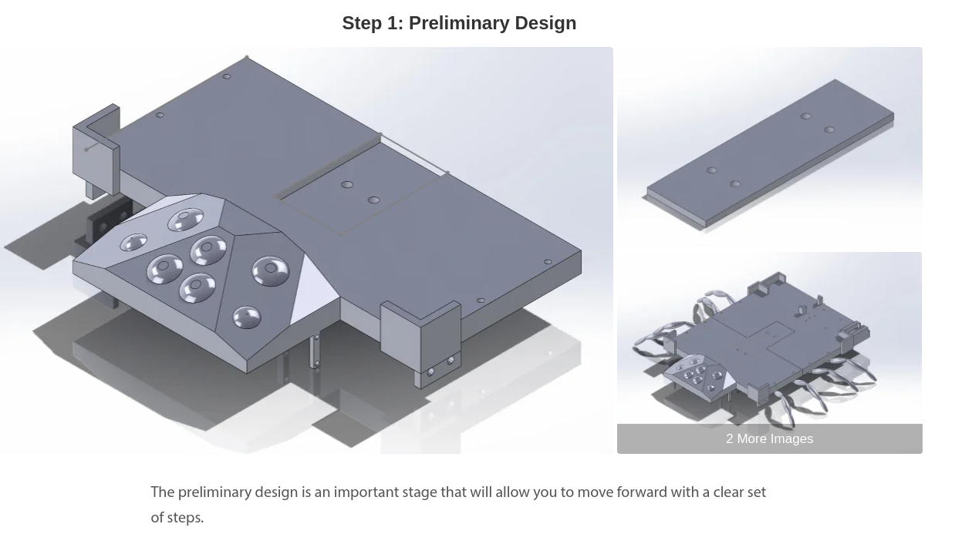
Website update

Slide 20
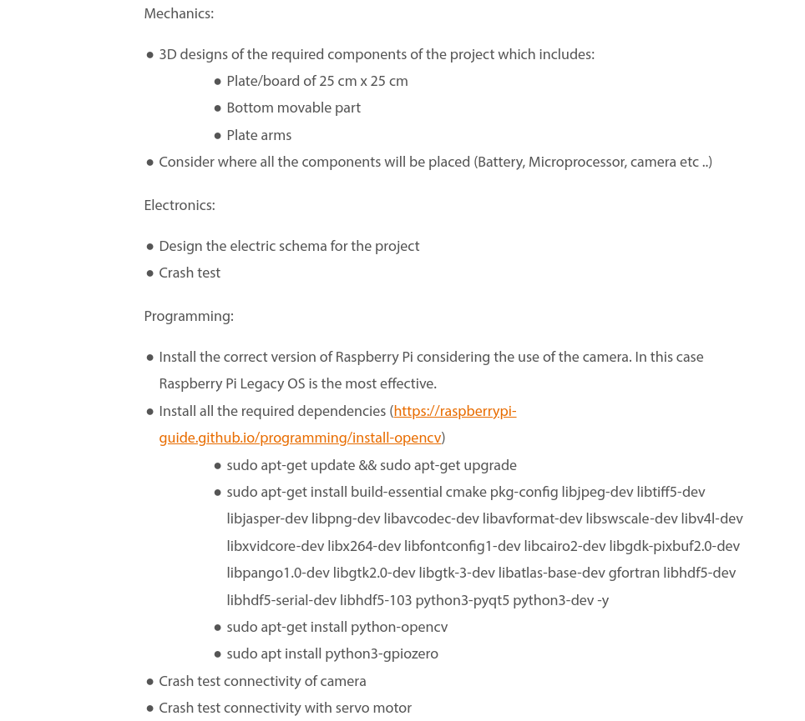
Website update

Slide 21


